Slide 1
Predicting Automobile Fuel Economy
Daniel J. Park
Williams College STAT 346
December 7, 2018
Notes:
Hi. I’ll be sharing my work on predicting automobile fuel economy.

Slide 2

The Question and Context
Car manufacturers are responsible for following the EPA’s complicated process to measure fuel economy in miles per gallon (mpg)
Can we predict mpg using a car’s more easily measurable attributes?
Notes:
To give some context to the subject of fuel economy in the United States, car manufacturers are the ones responsible for testing their cars and measuring mpg (miles per gallon) according to a complicated set of rules and procedures established by the EPA (Environmental Protection Agency). This mpg measurement procedure involves lots of steps and drive cycles and formulas, so the question I ask is: can we use attributes about a car that are easier to measure to predict its mpg?

Slide 3
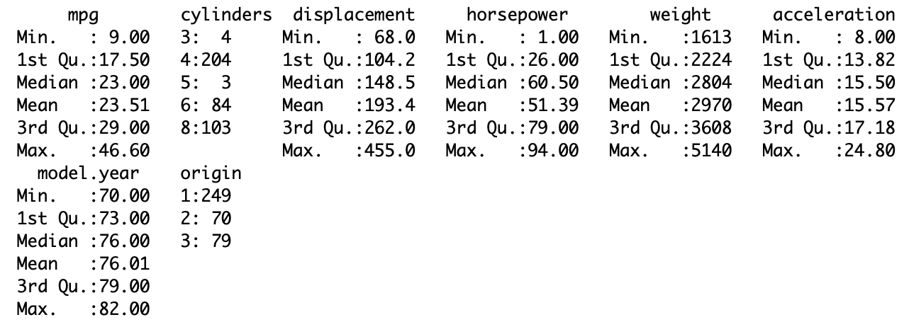
Introducing the Dataset
Contains data on 398 cars built from 1970 to 1982
Presented at the American Statistical Association’s 1983 Exposition
Variables
mpg
Cylinders
Horsepower
Displacement
Weight
Acceleration
Model year
Origin
Name
Notes:
So I analyzed a dataset I found on the UC Irvine Machine Learning repository. The dataset was published in 1983 and contains data on 398 cars. There are 5 continuous predictors and 3 discrete, multi-valued predictors:
number of cylinders is a categorical variable
engine displacement in cubic inches
horsepower
weight in pounds
time it takes to accelerate from 0 to 60 mph in seconds
model year in the 1900s
origin of the car is also categorical (1. American, 2. European, 3. Japanese)
and car name.
I decided to drop the Name variable because almost all the car had distinct names, so it would have taken hundreds of indicator variables to encode the cars, and I reasoned that the name of a car doesn’t tell you much about how it’s actually built.
This dataset was presented at the American Statistical Association's 1983 Exposition, so I'm not concerned about data collection, and it doesn't have any missing values.

Slide 4
mpg.dat Summary
Potential source of leverage:
Few cars with 3 or 5 cylinders
Notes:
Looking at the dataset summary, there’s a potential source of leverage we should keep in mind. There are four cars determining the coefficient for the Cylinders=3 variable, and only three cars to determine the Cylinders=5 coefficient, so those cars will have a big influence because there are so few data points in those categories.

Slide 5
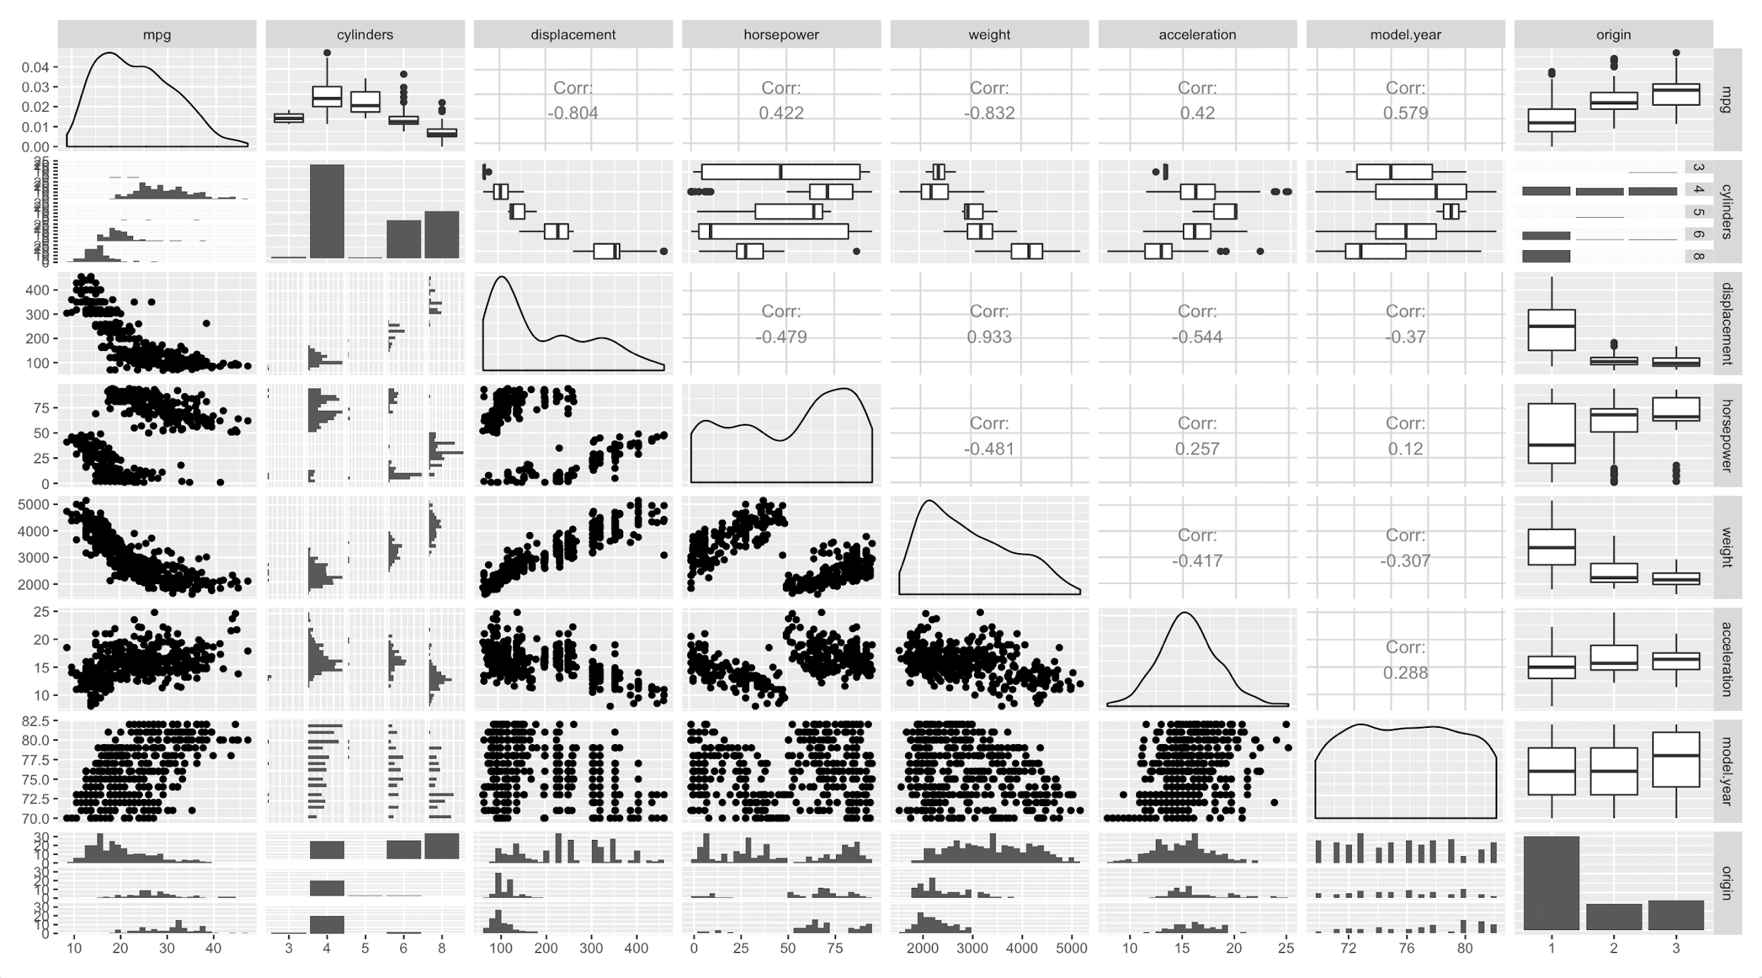
ggpairs(mpg.dat)
Notes:
In terms of their quantitative attributes, none of the cars seems to have an extreme value for a predictor, so I’m not worried about more potential high-leverage points.

Slide 6
Checking Diagnostics and Conditions
Fit initial full model with no interactions
mpg ~ cyl + disp + hp + wt + acc + yr + origin
Checking assumptions and conditions
Is linear relationship appropriate?
Normal errors?
Constant variance?
Influential points?
High residual, high leverage points?
Notes:
To start checking whether the assumptions I made for a linear model were met and what the diagnostics were for a linear model, I fit a full model with no interactions.

Slide 7
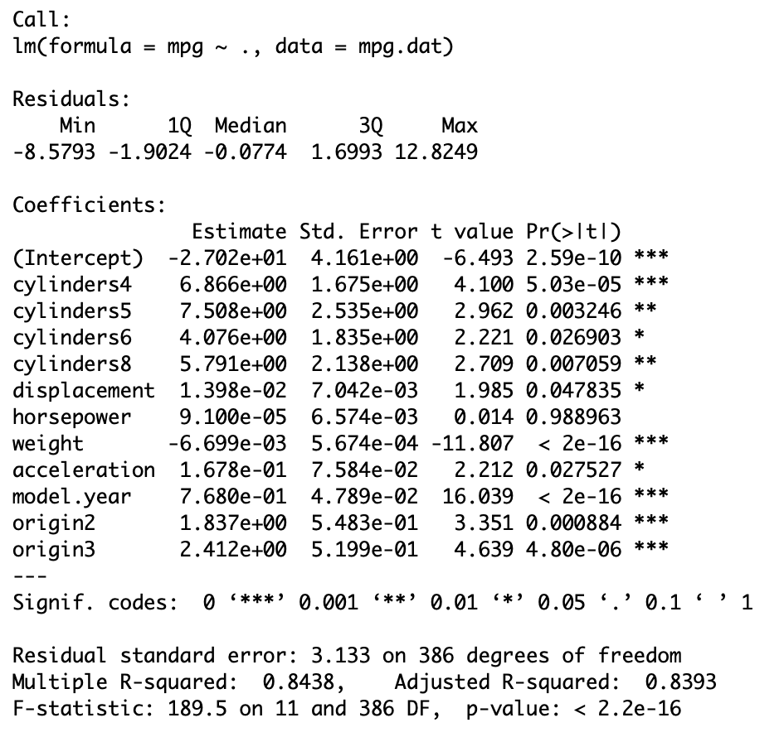
summary(full.model)
Notes:
Here’s the summary of my full model. I consider the R-squared value of 0.8438 to be pretty high; it’s saying 84% of the variation in mpg can be explained by our model. Notice that horsepower is not a significant coefficient, although overall, the result of the F test is showing us that the model is better than using only an intercept.

Slide 8
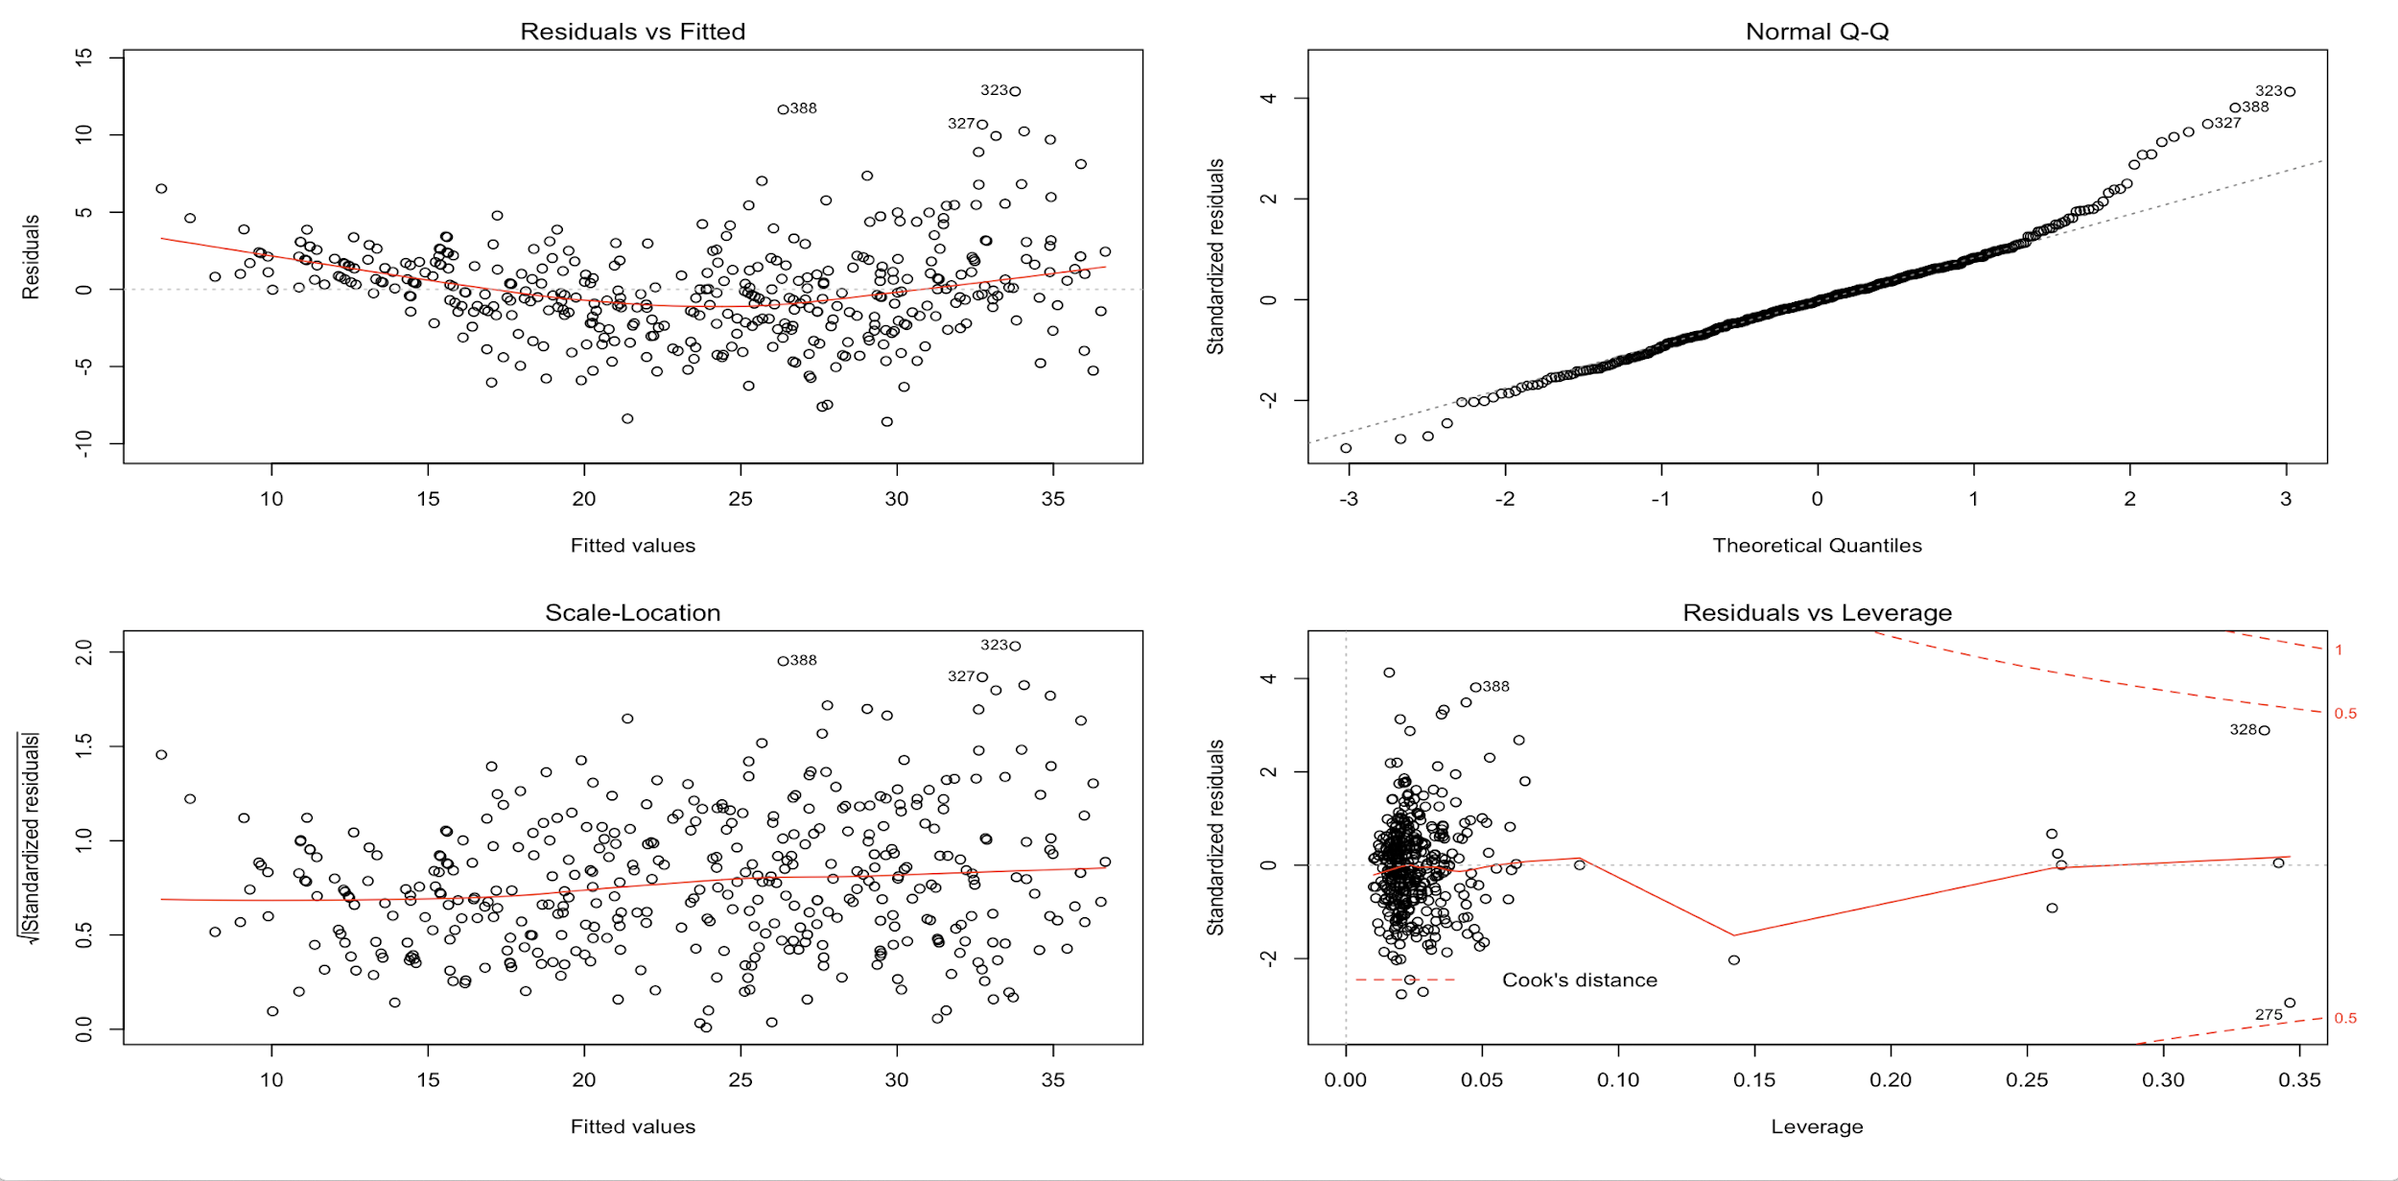
Diagnostics
Notes:
Here are some plots of the residuals. There are two big issues I need to address. First thing to note is the slight quadratic shape to the residuals, so a linear model may not be appropriate here. Another glaring issue is the heteroskedasticity of the residuals; the constant variance assumption is definitely not met.
The QQ plot is roughly linear, so we can assume the errors are approximately normal. While there are some large residuals, those points have low leverage and aren’t influential. Regarding the points with high hat values, like the 7 points inside the circle, they are all either in the 3- or 5-Cylinder category, which confirms my conjecture earlier about their potential high influence, but this is a consequence of not enough data for these categories.

Slide 9
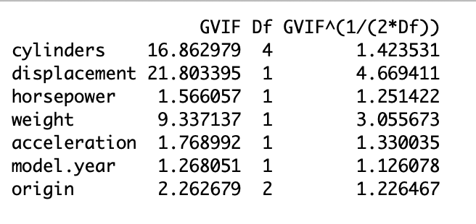
Diagnostics
Notes:
A third issue I see with this model is multicollinearity, which is supported by large VIFs for some predictors. In particular, Cylinders, Displacement, and Weight have VIFs close to 10 or higher, so these are unstable coefficients.

Slide 10
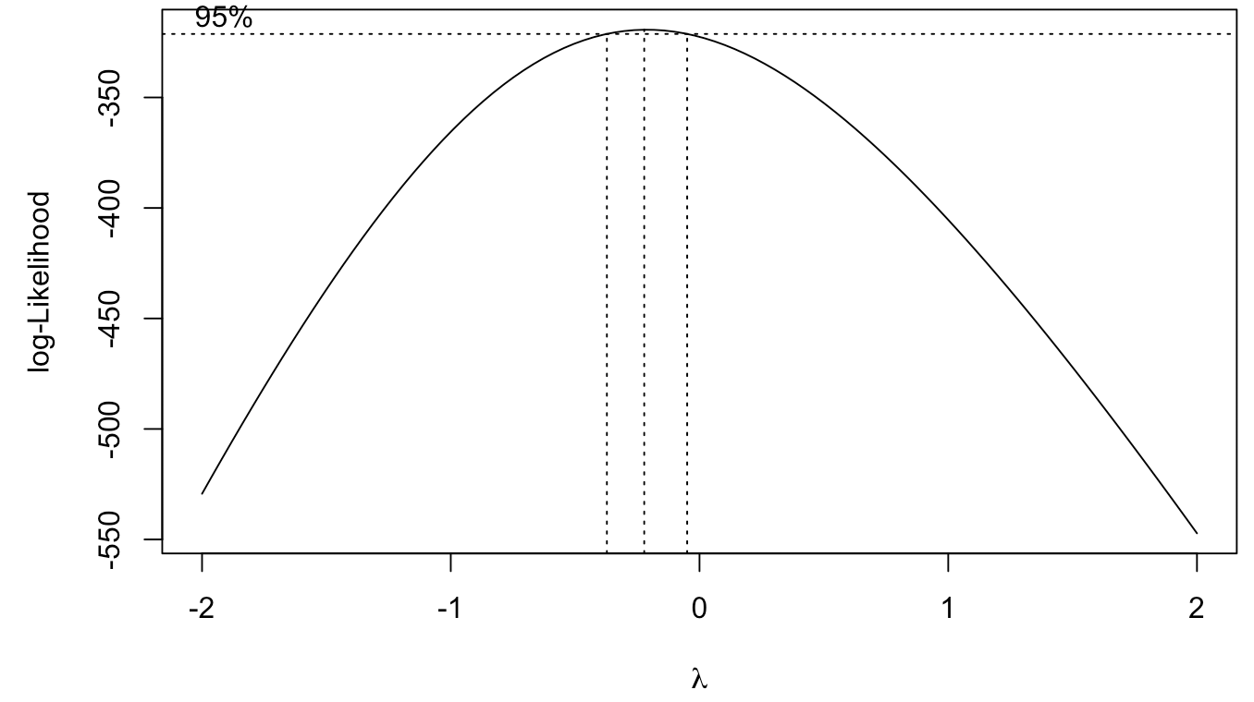
Fixes
First Fix: address non-linear relationship
R’s suggested optimal lambda:
-0.02
y → log(y)
Notes:
I found three issues with my initial model: Non-linear relationship between mpg and the predictors, heteroskedasticity, and multicollinearity. And I wanted to tackle the non-linear relationship first. So I used the Box-Cox method, and R suggested a lambda of -0.02. To make the transformation of mpg more interpretable, I decided to use a lambda of 0 and take the log of mpg and regress it on the predictors.

Slide 11
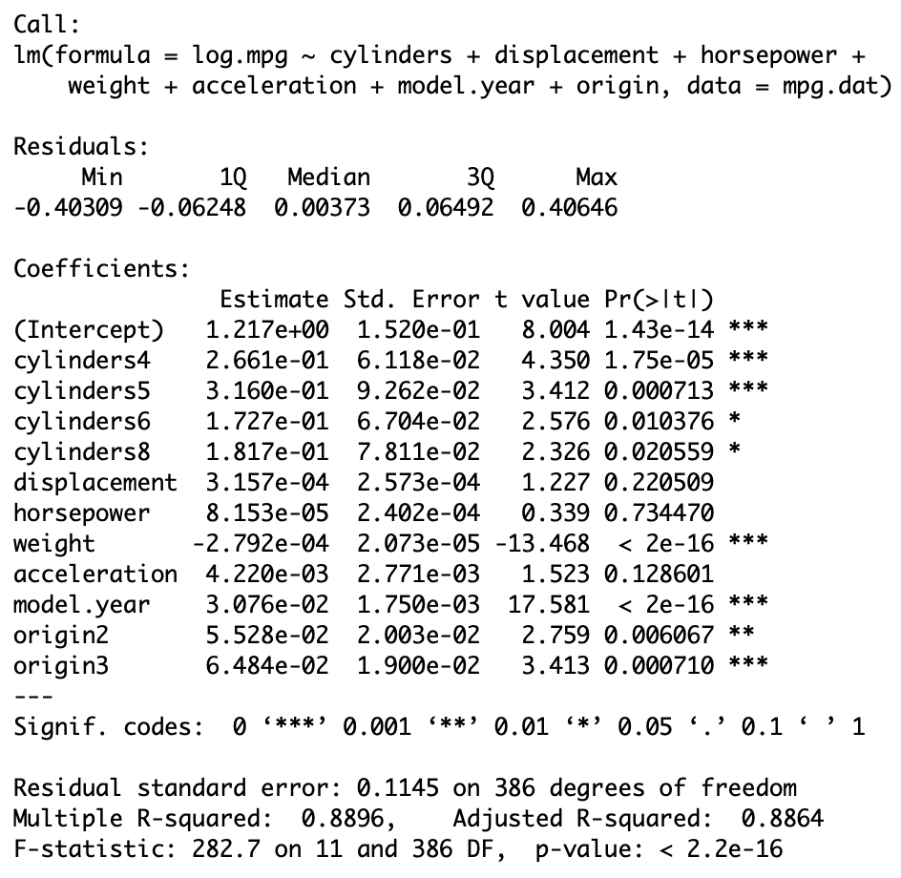
log(mpg)~cyl+disp+hp+wt+acc+yr+origin
summary(log.model)
Notes:
Here’s a summary of the log of mpg regressed on all predictors. To compare with the non-transformed model, we have more coefficients that are not significant, so there’s an opportunity to do some model selection and drop some predictors from the model.

Slide 12
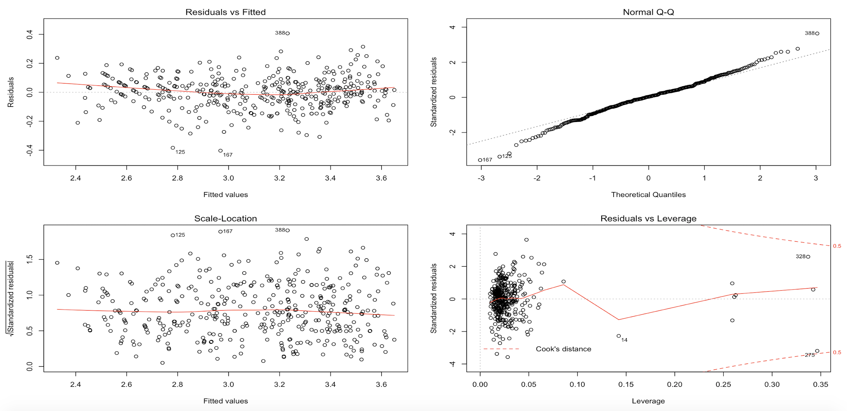
Diagnostics
Notes:
Wow. Looking at some residuals plots, using the log model solved two issues. Now the fitted residuals plot shows no pattern, we have constant variance, and the errors are approximately normal.

Slide 13
However...
Large VIFs are still an issue
Options:
Model selection
Stepwise-like process
Force coefficients to be smaller
LASSO
Notes:
But, there’s still the issue with multicollinearity and unstable coefficient estimates. At this point, I thought of two approaches to fix the issue.
One was to use a stepwise-like process where I dropped the variable with the highest VIF above 5 one by one, until no variable in the model had a VIF greater than 5. Then use stepwise regression on the remaining predictors. The benefit of this approach is that the coefficients of the best stepwise model are interpretable in terms of mpg if we exponentiate them. So we could say, “accounting for all other predictors, for each 1-unit increase in (weight) we predict mpg to change by e raised to the coefficient for (weight) - 1 * 100%.” And, we could have a simpler model, getting rid of predictors that aren’t useful while still explaining a lot of the variation in the response.
My second approach is to use LASSO regression directly on the full log model, forcing the coefficients to be smaller. I chose LASSO over ridge regression because I’m interested in seeing whether I can reduce the dimensionality of the model if LASSO forces some coefficients to 0.
I’ll go over what I did for the first approach, and if there’s still time I’ll talk about the LASSO approach.

Slide 14
Steps in Approach 1
Drop Displacement (VIF = 21.8)
Drop Cylinders (VIF = 9.5)
No predictors have VIFs > 5
Bidirectional stepwise regression using AIC criterion (drop acceleration)
Final model: lm(log(mpg)~horsepower+weight+model.year+origin
Notes:
Here are the steps I took in the first approach. At each step, I fit a new model excluding the predictor I had dropped.

Slide 15
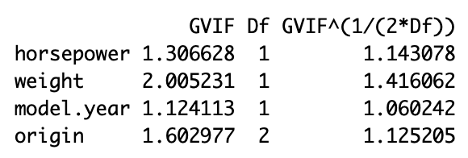
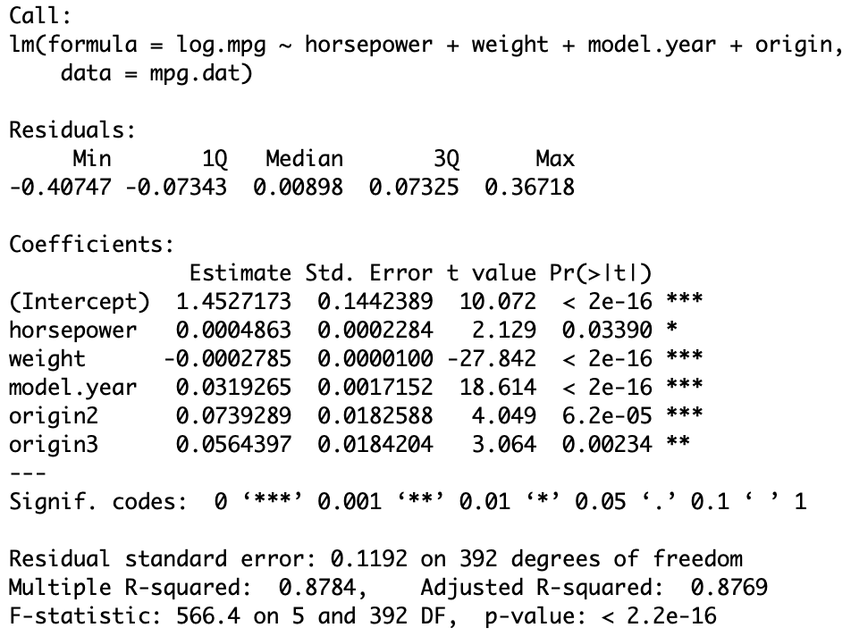
Final Model 1:
Multicollinearity no longer an issue
R-squared: 0.8784
Exponentiated coefficients
Intercept: 4.2747
Horsepower: 1.0004
Weight: 0.9997
Model.year: 1.0324
Origin2: 1.0767
Origin3: 1.0581
Notes:
And I obtain a final model using this process regression the log of mpg on horsepower, weight, model year, and origin. We started with an initial full log model with R squared .8896, and we’ve been able to maintain a high R squared of .8784, while fixing multicollinearity. As you can see, our VIFs are all under 5.
To interpret the coefficients,in terms of mpg, we have to exponentiate them, and interpret them as a percent change in mpg after subtracting 1. So for example, after accounting for all other predictors, the average mpg of a European car is 7.67% higher than the average mpg of an American car. The average Japanese car also has a high mpg than the average American car.

Slide 16
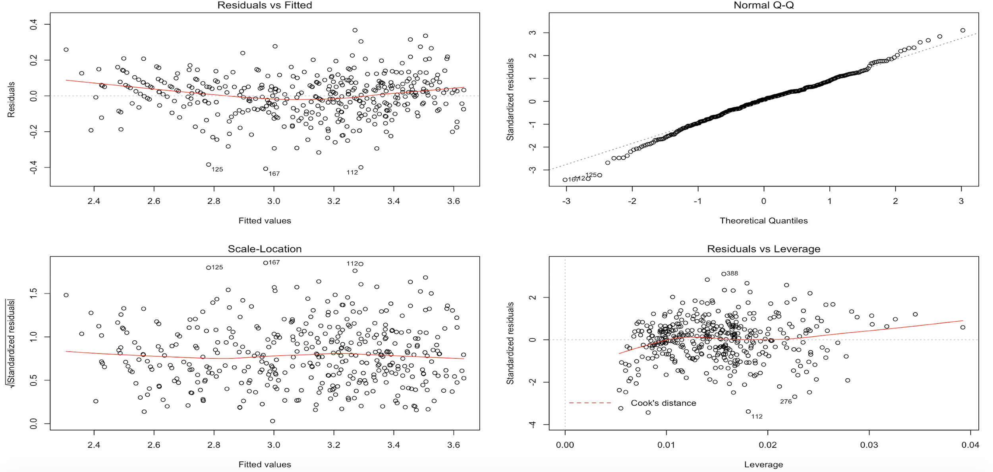
Diagnostics for Final Model 1
Notes:
I like the residual plots for this model much more than the ones we’ve looked at before. The residuals are showing less of that clear pattern we saw before, they’re displaying more constant variance, they’re approximately normal, and we don’t have any extremely influential residuals with a large Cook’s Distance.

Slide 17
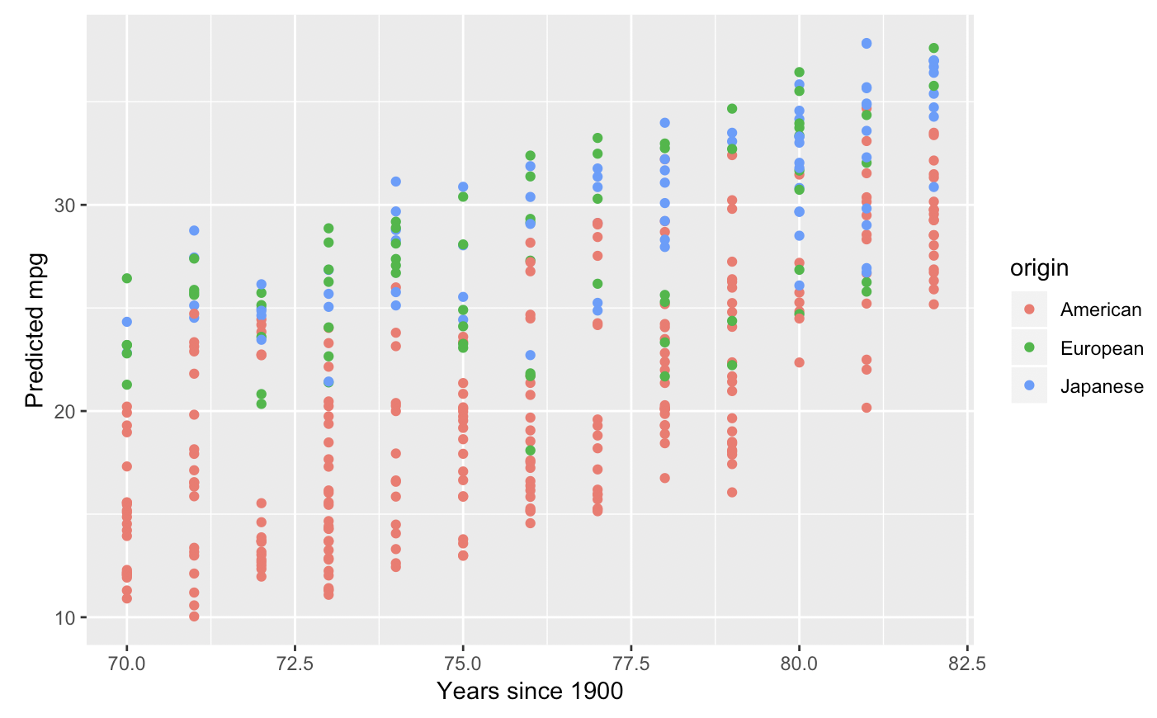
Predicted mpg versus Model Year
Notes:
Here’s a visualization of one aspect of the model. I exponentiated the predicted log mpgs and plotted them against model year, color coded by origin. As expected from the positive coefficient for model year, we see a positive trend. And we see that for a given year, American cars tend to have lower mpgs than European and Japanese cars.

Slide 18
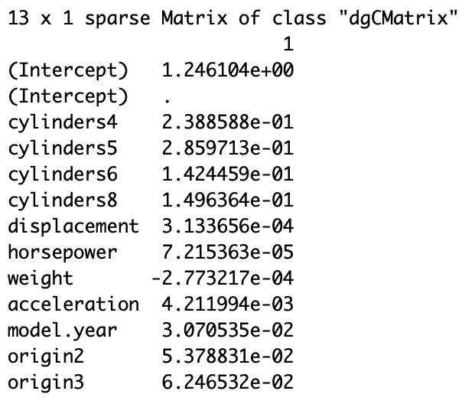
Steps in Approach 2
LASSO method on full log model
Cross-validation to obtain optimal lambda parameter
Find model using optimal lambda
No predictors dropped
Coefficients are forced to be smaller
Penalty: sum of absolute coefficients
R-squared: 0.8894
Notes:
Here are the steps I took in Approach 2. I obtained the optimal LASSO model, which turned out not to drop any predictors. The coefficients in this model are less directly interpretable than the ones in the previous model because we are enforcing a penalty to shrink them. We’re still using all the attributes about the car to predict its mpg, which means we could be more accurate on this dataset.

Slide 19
Conclusions
Both approaches do well in terms of prediction
High R-squared values ~0.90
Prediction for automobile fuel economy
Limitations
Model Year variable
More than one mpg
Other important variables?
Further research
Data collection for other attributes
More recent data
Interaction terms
Notes:
What I found in both approaches is that the final model explains about 90% of the variation in the log of mpg, so it seems we can use more easily measurable attributes about a car to predict its mpg pretty well. While car manufacturers won’t allowed to use predictions from one of my two models, they could use it as an early indicator to estimate the mpg of their cars.
There are limitations to the application of this model, though. One is the inclusion of the model year variable. Since all the cars in our sample were built in the 70s and early 80s, using this model to predict more recent car models is extrapolation and will overestimate the mpg. Second, mpg depends on the driving environment, whether the car is in the city or the highway, so to represent mpg with one number is somewhat misleading, because it could be the output of some formula using city and highway mpgs. Another limitation of the model is the exclusion of variables that could be highly useful for predicting mpg. I don't know much about cars, so there may be other variables I should be measuring as predictors that I'm not including.
That being said, there’s a lot that could be done in further research into this question of predicting mpg. We could include data on other useful attributes that I didn’t include in my models. Build a model from more recent data if we’re interested in predicting recent car models. And I didn’t do an analysis into potential models that use interaction terms, which would allow for more terms to be in the model and have effects depend on the levels of other predictors.

